Slide 1
Performance Analysis & Improvement Proposals
Juan Fernandez Pradillo

Slide 2

Wind Farm Performance Overview
Total Energy Produced: 39.5 GWh
Energy Lost due to Stoppages: 1.23 GWh
Time-Based Availability: 97.5 %
Energy-Based Availability: 96.99 %
Average Wind Speed: 6.0 m/s

Slide 3
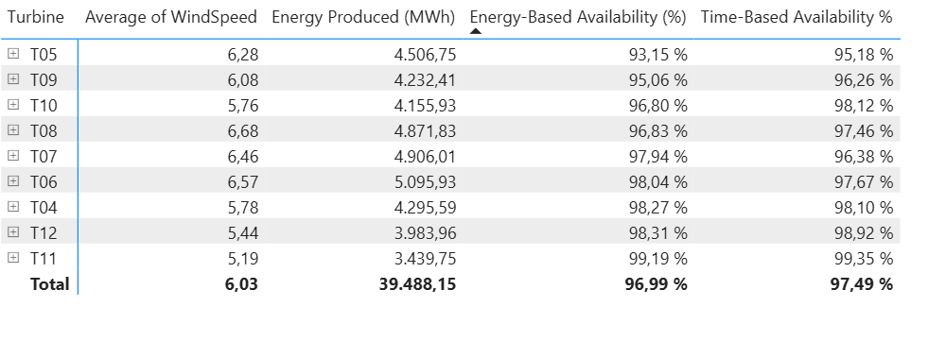
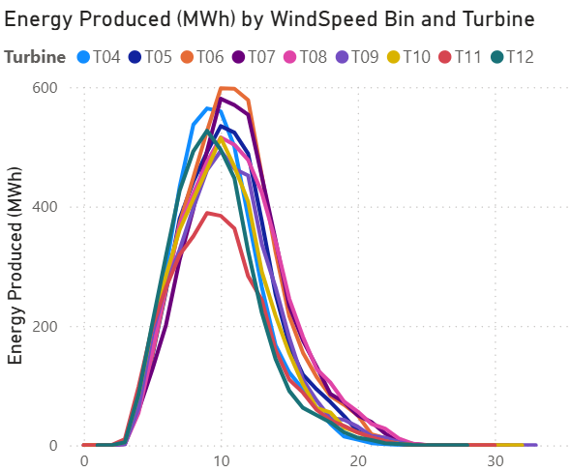
Performance Analysis 1
Turbine | Observation
T05-T09–T10 | Show slightly lower availability due to extended stoppages early in the year (March–April), which also explains their relatively reduced energy output compared to turbines with similar wind exposure
T06–T17 | the top performers, combining strong availability (>97%) with high energy yield, closely following the OEM power curve.
T11 | Lower average wind (≈ 5.2 m/s) but excellent Energy-Based Availability (99.2 %), showing stable operation at low resource.
Juan Fernandez Pradillo

Slide 4
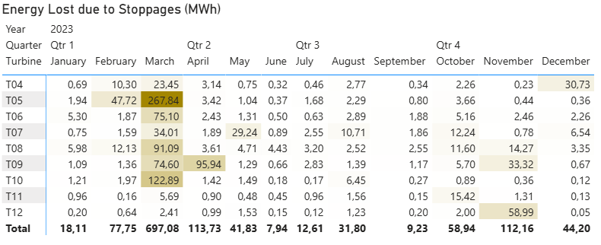
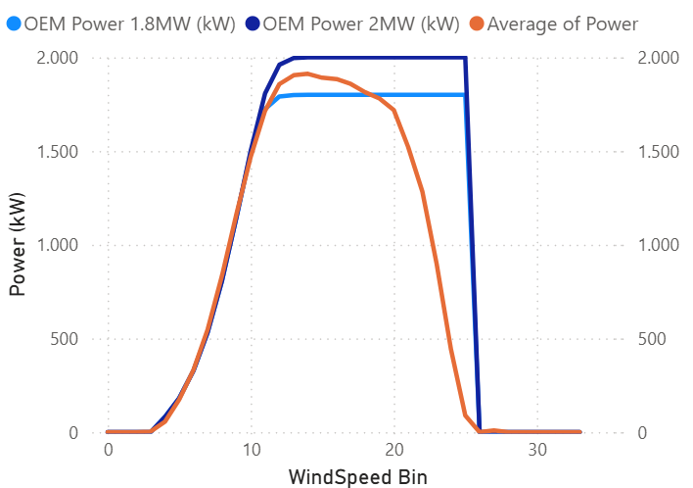
Performance Analysis 2
The monthly breakdown of Energy Lost due to Stoppages (MWh) shows a clear concentration of downtime events during March 2023, when most turbines recorded significant production losses.
Most turbines closely follow the expected OEM curve (V90-2 MW) up to 12 m/s
Juan Fernandez Pradillo

Slide 5
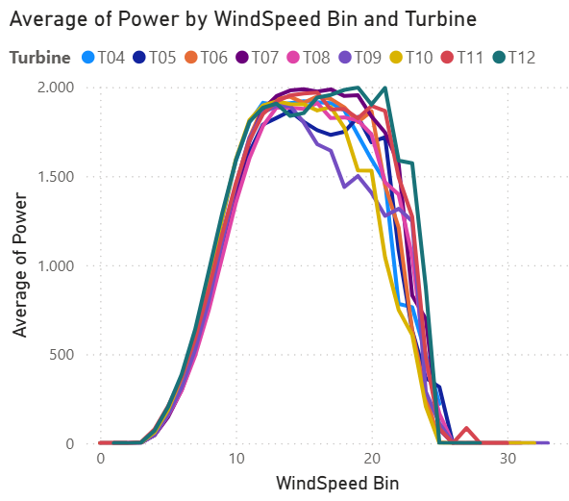
Performance Analysis 3
Turbine Performance Summary: • T04 – Stable and close to OEM curve, reference turbine. • T05 – Major shutdown in March (268 MWh loss), low availability (93%), its follo 1,8 MW OME curve. • T06 – Best performer (5.1 GWh), excellent alignment with OEM curve. • T07 – At higher speeds (above 16 m/s), it still tracks the OEM closely. • T08 – Normal behavior, small deviations at high winds. • T09 – April shutdown (96 MWh). Above 12–14 m/s: clear underperformance vs. OEM. • T10 – March outage (123 MWh), Above 19 m/s: clear underperformance vs. OEM. • T11 – High availability (99%), low wind site but efficient. • T12 – Slightly lower winds, normal curve, minor November downtime.
Juan Fernandez Pradillo

Slide 6
Further KPIs and Analysis to Improve Monitoring
KPI | Description | Insight
Capacity Factor (%) | Energy produced / (Nominal Power × Time) | Overall efficiency of each turbine
Performance Ratio (PR) | Actual production vs. expected from OEM curve | Detects aerodynamic or mechanical losses
Production vs. Wind Direction | Scatter by direction sectors | Reveals directional underperformance or obstruction
Power Factor | Tracks grid compliance and electrical efficiency | Detects curtailment or grid connection issues
Mean Time Between Failures (MTBF) | Average time between corrective stoppages | Measures reliability
Additional Data Sources to Integrate
SCADA Alarm Logs → classify faults, calculate alarm frequency and duration.
Status Codes / Operating Modes → distinguish between grid curtailment, maintenance, and technical stoppages.
Juan Fernandez Pradillo

Slide 7
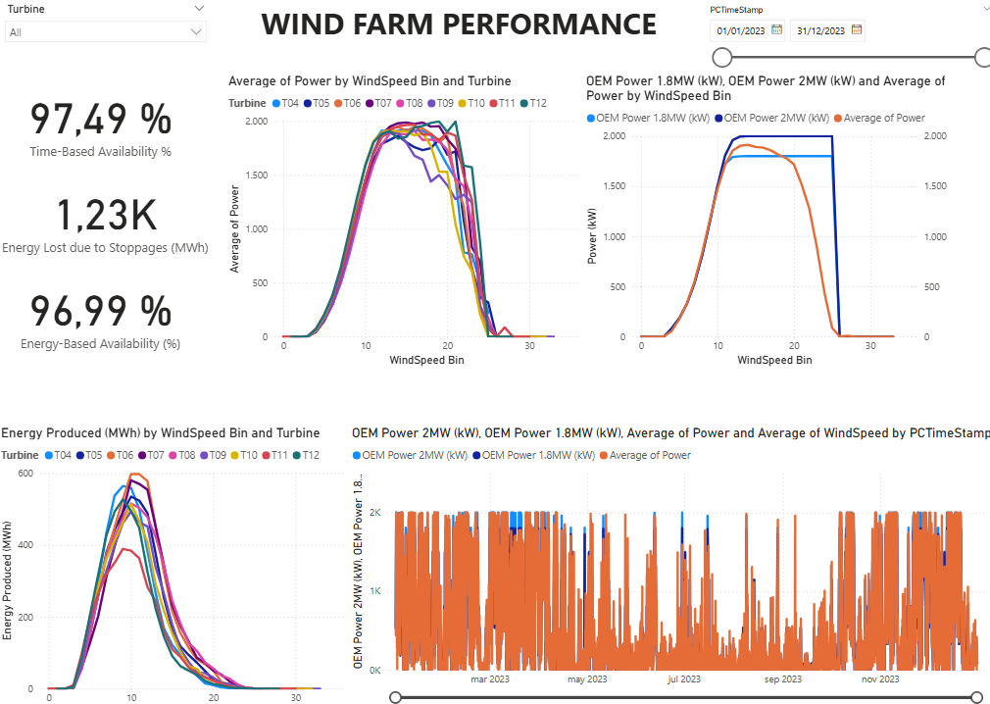
Power BI
Juan Fernandez Pradillo

Slide 8
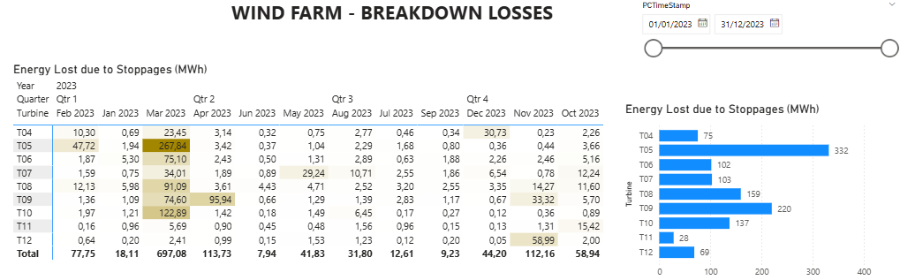
Power BI
Juan Fernandez Pradillo

Slide 9
Power Query
The raw data comes from an Excel file with 10-minute turbine measurements.
Each turbine had separate columns for Power and Wind Speed — not ideal for Power BI analysis.
The goal is to reshape the dataset into a tidy format: Timestamp | Turbine | Power | WindSpeed | Availability
Power Query was used to:
Clean headers and data types
Unpivot colums — one row per measurement per turbine.
Merge Power and Wind Speed
Detect downtime periods
Juan Fernandez Pradillo

